Slide 1
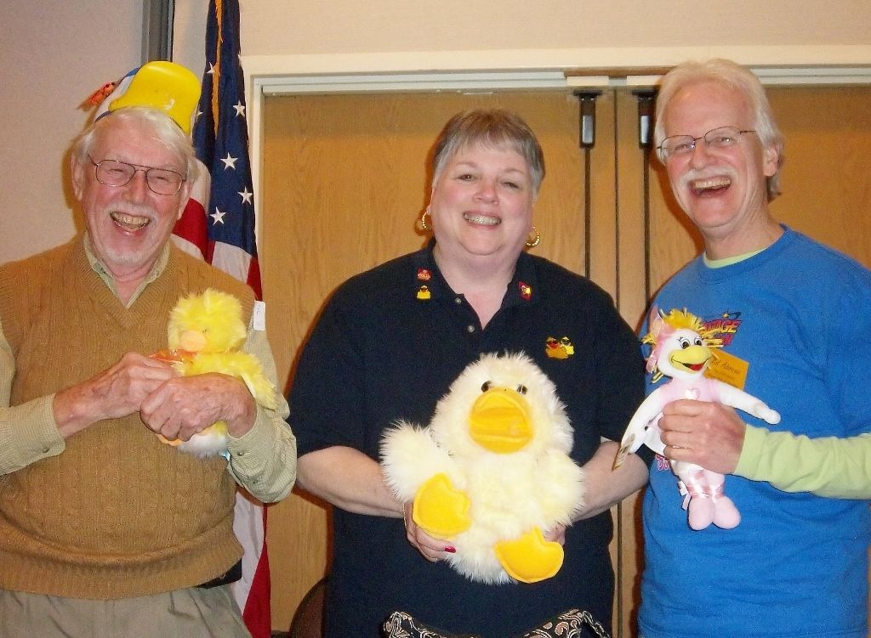
Dr. Mike Gass Rotary Memories
Spelling Bee - Mike Gass, Elayne Burton, Ed Ahrens

Slide 2
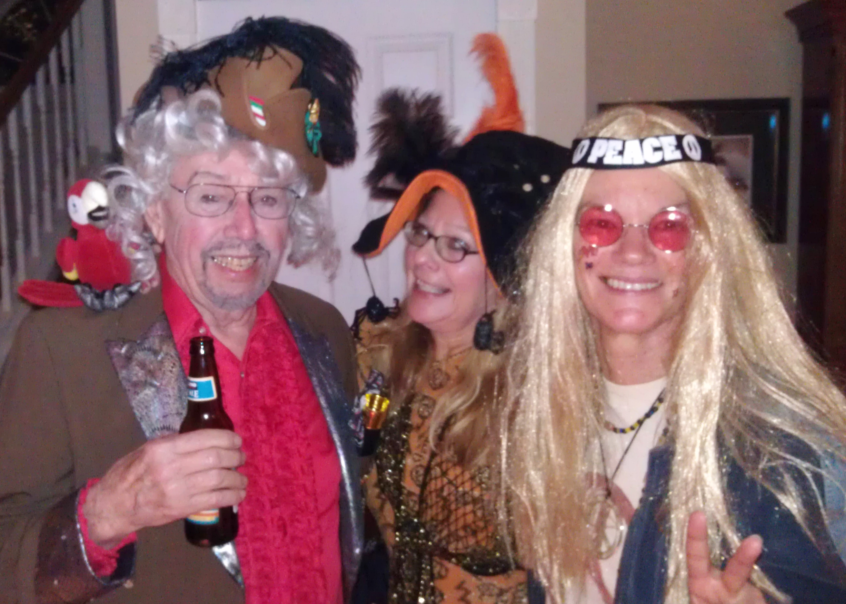
Dr. Mike Gass - Silverdale Rotary Club 1998-2022
Spelling Bee
Rum Balls
Duck Eggs
Arkane jokes
Rum Balls
Chicken Eggs
Dressing up
2011 with longtime friend (center) and Barbara Beagle

Slide 3
Literacy Council Spelling Bee – 200? - 2016
Mike Gass, Elayne Burton, Ed Ahrens – First Place Year after Year

Slide 4
Literacy Council Spelling Bee
2016 Cheering Section – Barbara & Brian Beagle, Mike’s daughter, Christie Scheffer, Mary Hoover, Barbara & Roger Aydt, the Bee, Ed Hamilton, unidentified, Mike Gass, Ed Ahrens

Slide 5
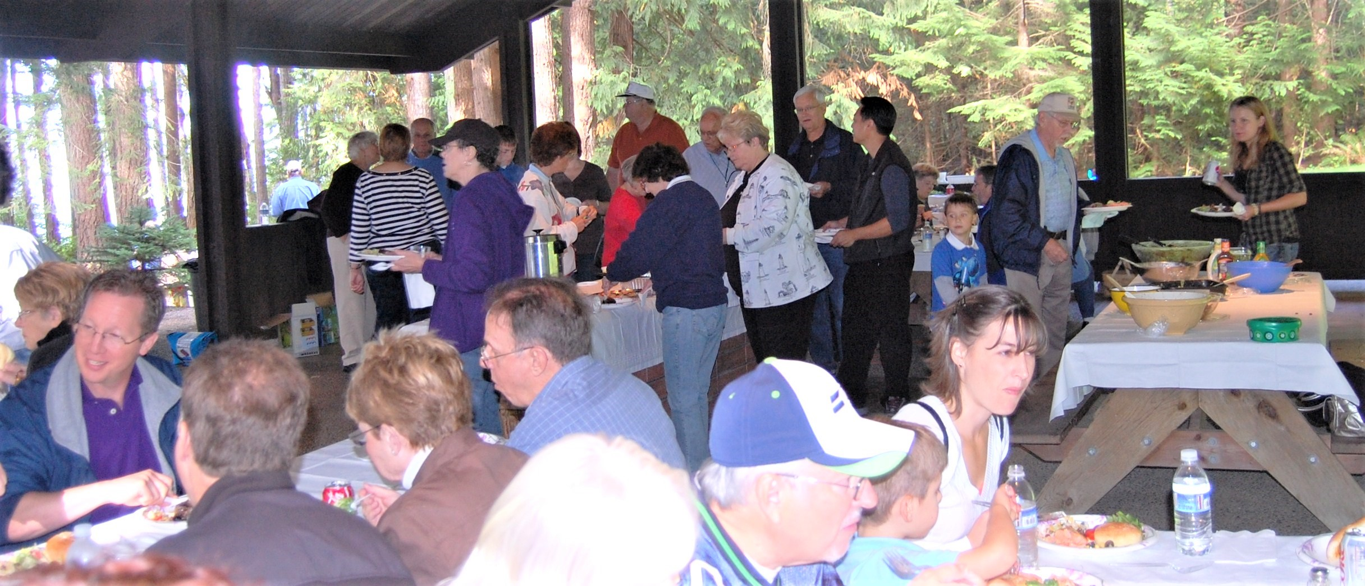
2010 Steak Fry – Scenic Beach State Park
Rum Balls!

Slide 6
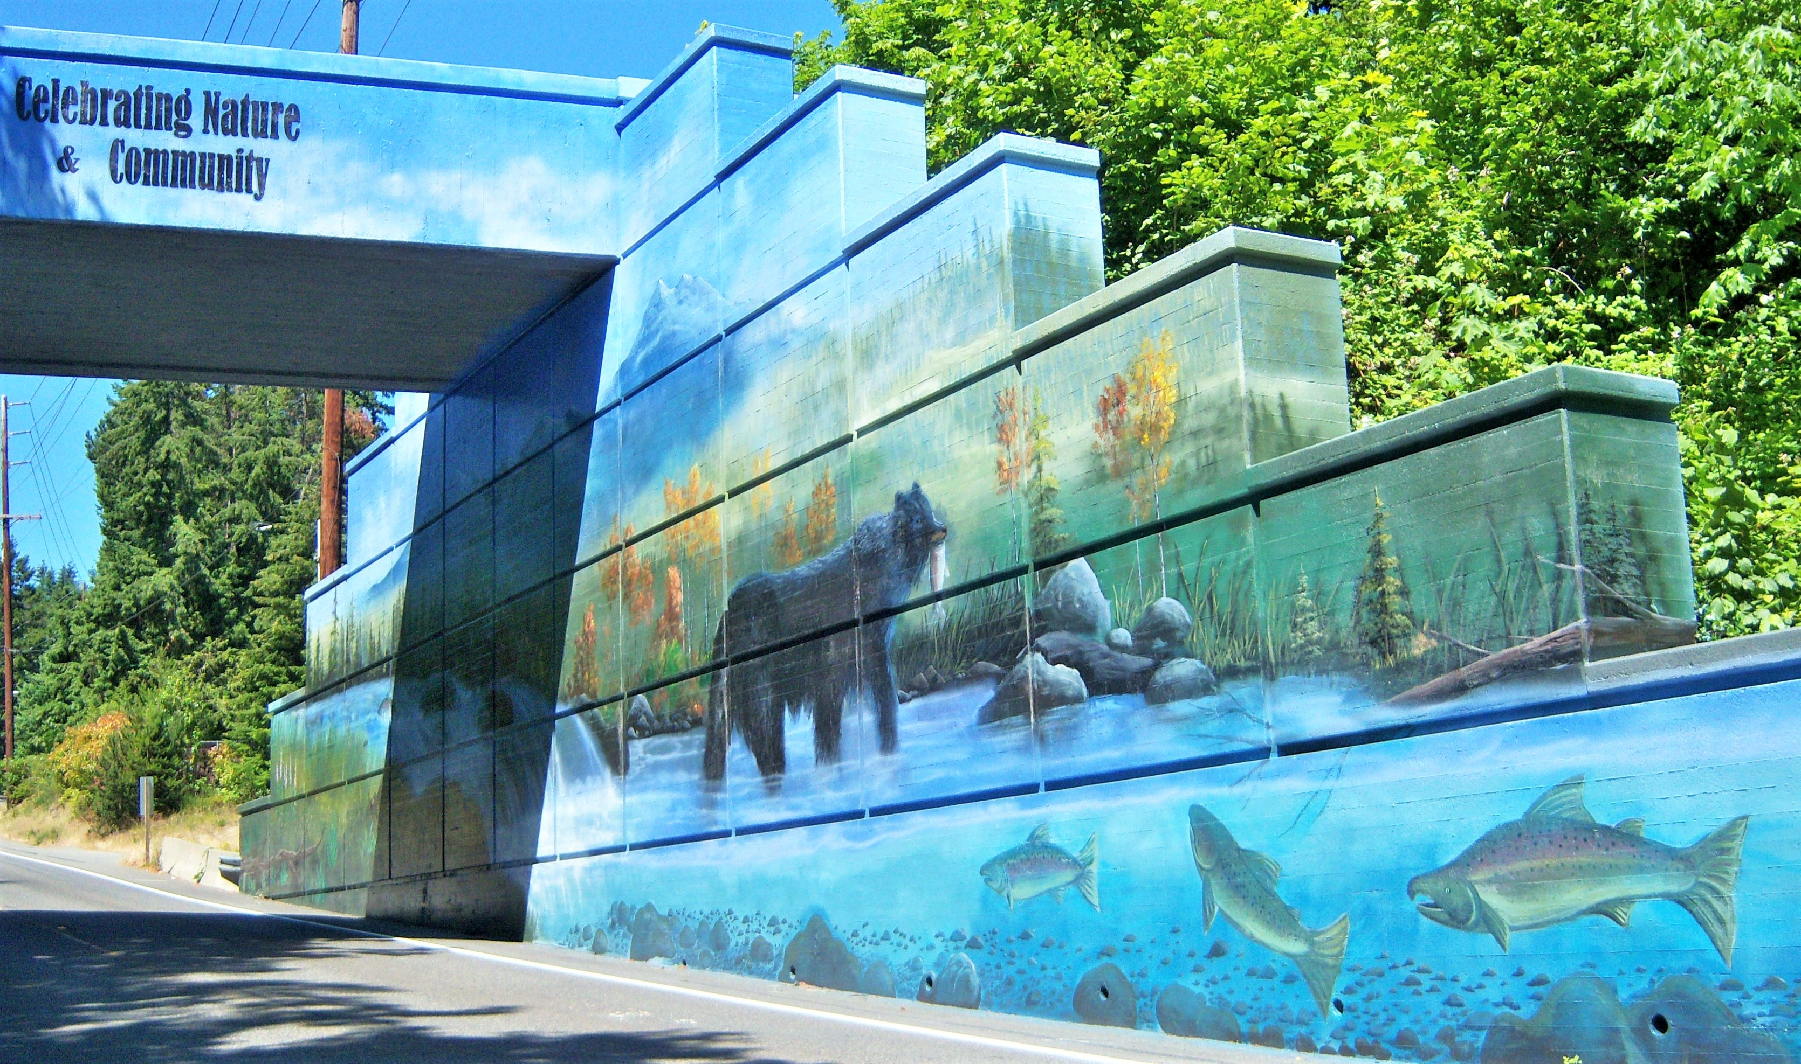
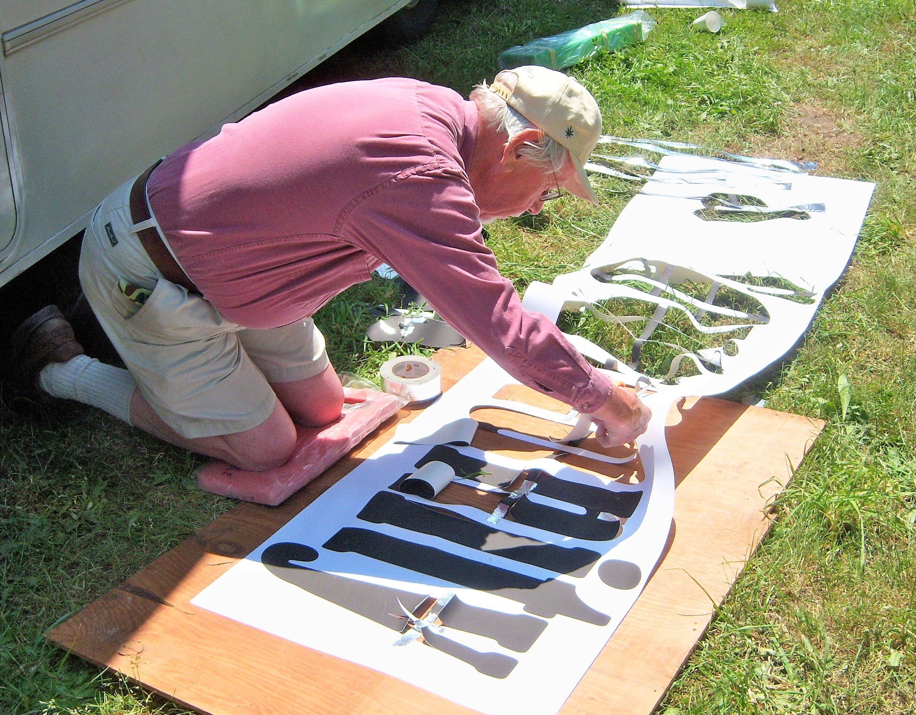
Anderson Hill Overpass Mural Project - 2009

Slide 7
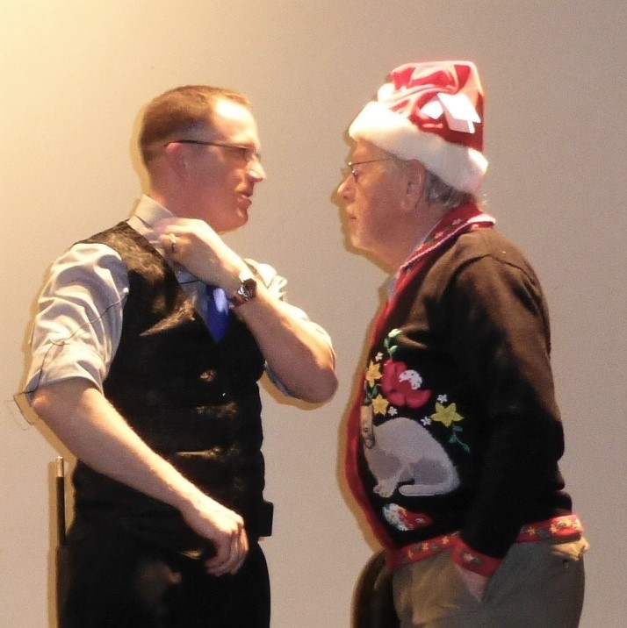
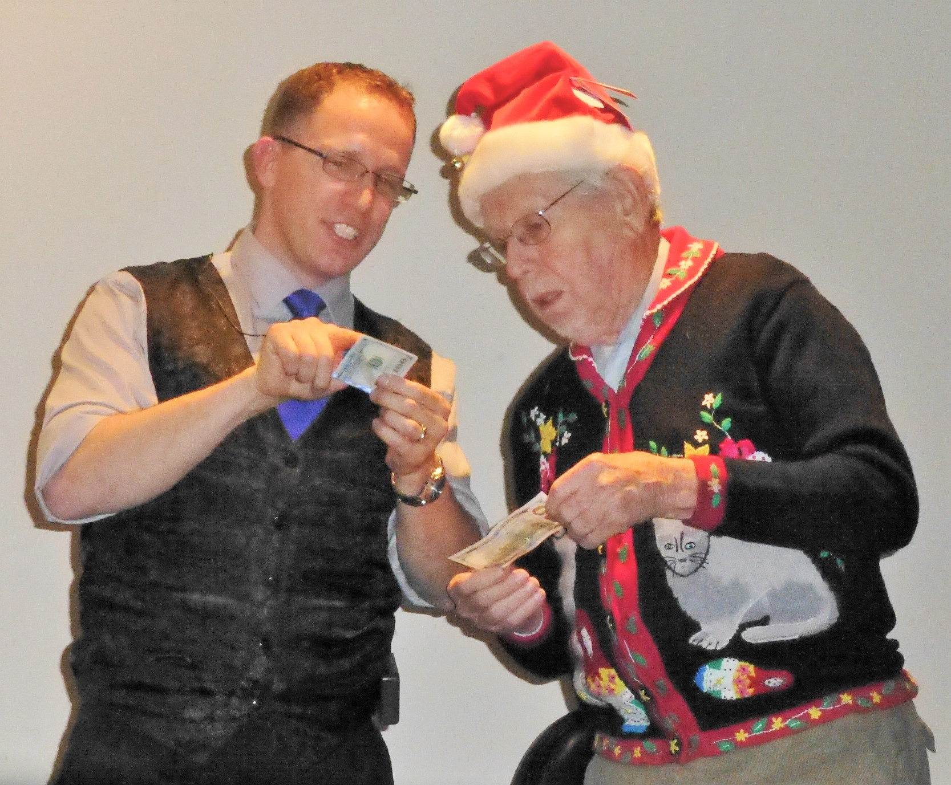
Holiday Party 2013
and…Rum Balls!

Slide 8
Steak Fry – 2009 – Six Guys
Jack Jensen, Steve Burton, Peter Matty, Mike Gass, Jim Pledger, Bill Bryant

